Slide 1
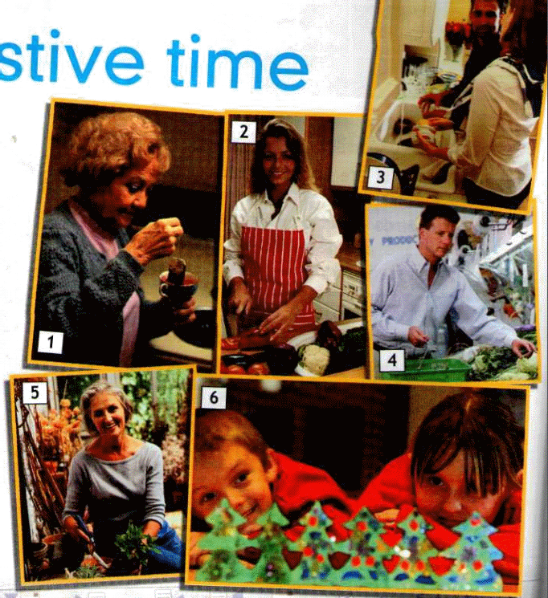
FESTIVE TIME
FE

Slide 2
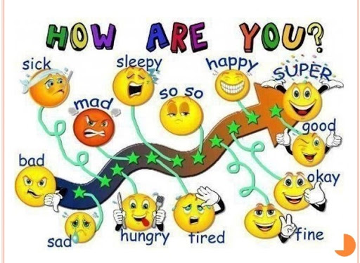
I`m…

Slide 3
We have to:
answer the questions
read the text
listen to the text
translate sentences and words
repeat the grammar rules
write the sentences and words
repeat the words
make up the dialogues
make up the sentences
describe pictures
play games

Slide 4
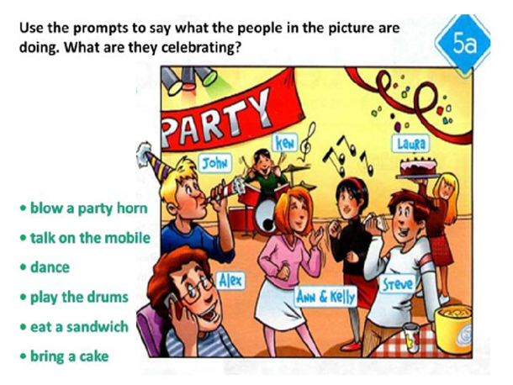
IS, ARE+ V-ING

Slide 5
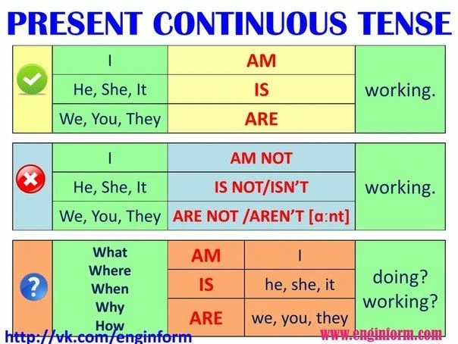

Slide 6
BRAINSTORMING Your task is to say the words associated with FESTIVE TIME
shopping, a cake, a special dish, the washing up, tea,
the decorations, the gardening, the dusting, a phone call, invitation card, celebrate, decorate, exchange gifts, have a great time, festival, colourful, presents
FESTIVE TIME

Slide 7
Your task is to match the words to form phrases
Work in groups
1.light a gift
2. exchange b the house
3. decorate c lamps
4. make d a costume
5. wear e preparations
6. visit f the fireworks
7. watch g people
8. buy e dish
9. invitation f presents
10.special g card
11.bring h call
12.phone I cake

Slide 8
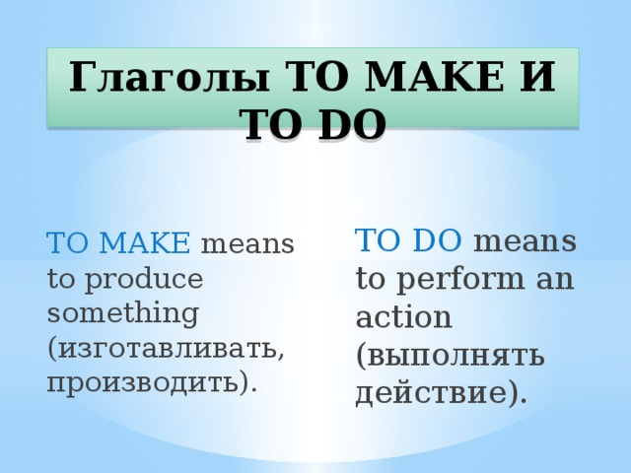

Slide 9

Рефлексия
Did you speak about making a preparation for a party?
answer the questions?
read the text?
sing songs?
Did you like our lesson? What did you like?
I liked songs/ poems/ tasks with words/ grammar/ reading/ pictures/ breaks/ work in groups/ work in pairs

Slide 10


